Slide 1
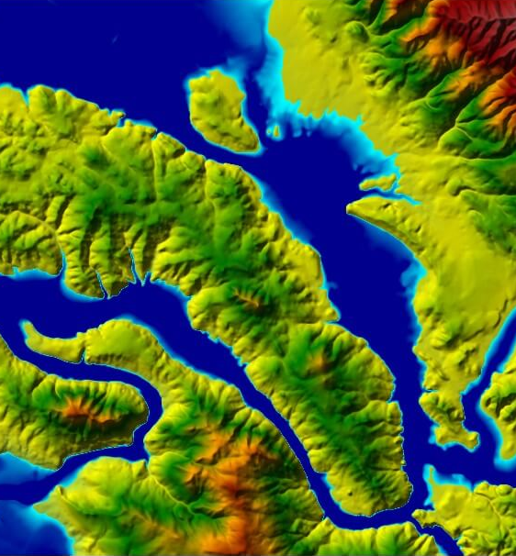
Flood Club
Hydrodynamic Modelling
Employable Water Resource Skills
HEC-RAS
First Meeting September 23rd
Check out Link to Find out More
https://drive.google.com/drive/folders/1h8zU0iL1ABFUa4LlbTzZUytoXcPmhKzx?usp=sharing

